Slide 1

EXPLORING THE IMPACT OF PERFORMANCE & EXPERIENCE ON BASEBALL SALARIES
Presented by Alex Webber
DSC 530 T304
Dr. Fadi Alsaleem
Page 01

Slide 2

Research Questions & Hypotheses
Salary Prediction
Question: Do a player’s offensive stats such as hits, home runs, and RBIs significantly impact their salary?
Null: No significant relationship between offensive stats and player salary.
Alternative: Players with higher offensive stats tend to have higher salaries.
Player Performance
Question: Do players with more years in the league perform better?
Null: Years in the league have no effect on hits and home runs.
Alternative: Players with more experience tend to have more hits and home runs.
League and Division Impact
Question: Does a player’s league (American vs. National) impact their salary?
Null: League has no impact on salary.
Alternative: Players in a specific league earn significantly more.
Page 02

Slide 3
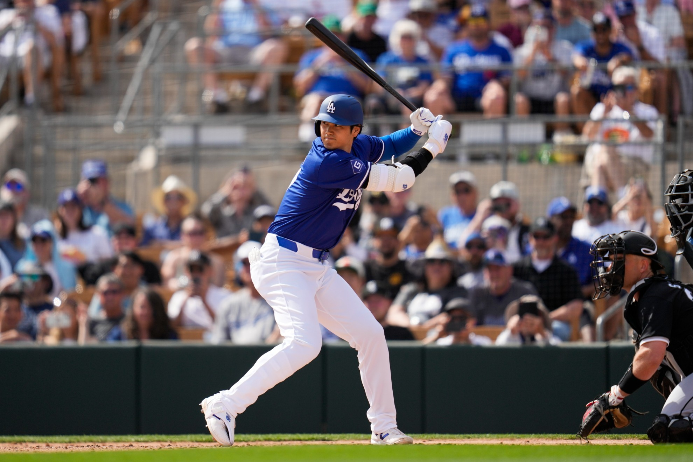
01
Hits
Number of hits in 1986
02
Home Run
Number of home runs in 1986
SEVEN VARIABLES USED DURING ANALYSIS
03
RBI
Number of runs batted in 1986
Salary
04
1987 annual salary on opening day in thousands of dollars
05
Years
Number of years played in the major league
League
06
A factor with levels A and N, indicating the player’s league at the end of 1986
Page 03
Division
07
A factor with levels E and W, indicating the player’s division at the end of 1986

Slide 4
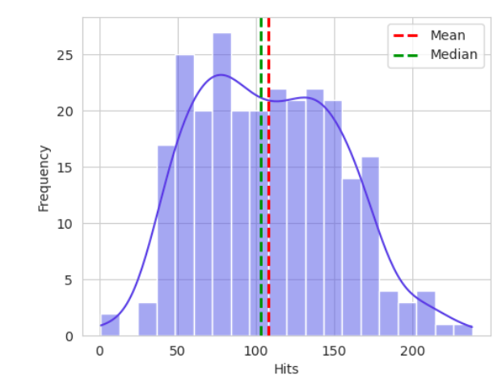

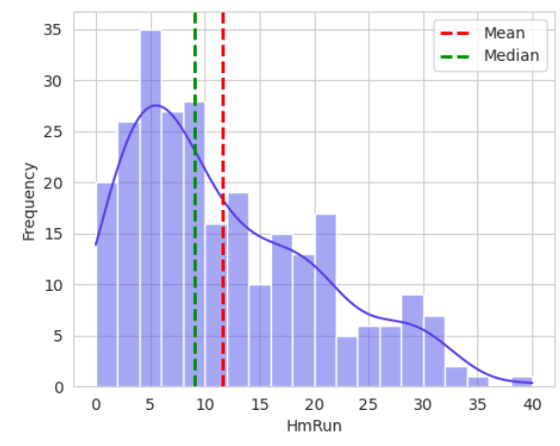
OUTLIER ANALYSIS & DATA DISTRIBUTION
Hits Distribution
Bell-shaped distribution. No outliers detected in Hits.
Home Run Distribution
Positively skewed distribution. One player hit 40 home runs, which is higher than the normal range. This outlier will not be removed since it represents either an elite or veteran player.
Page 04

Slide 5
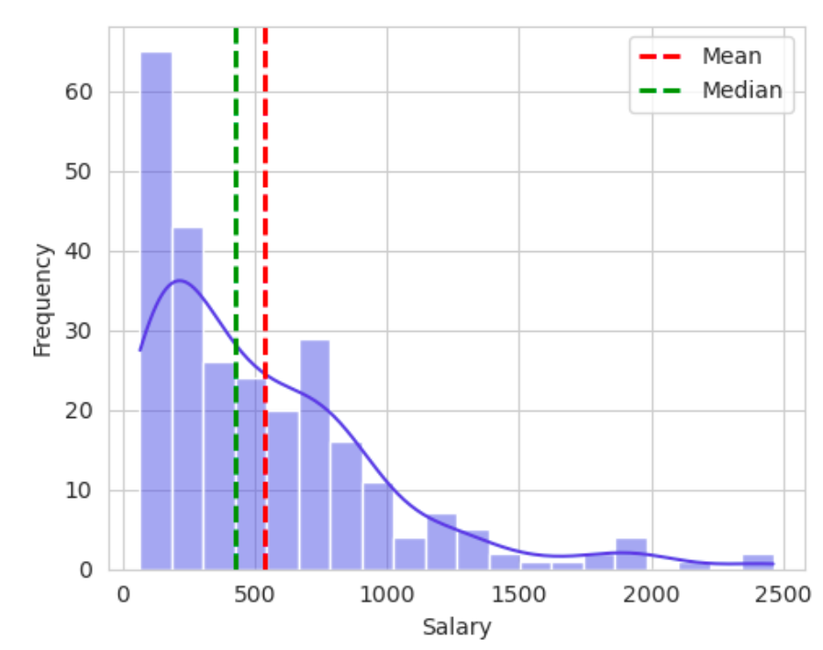

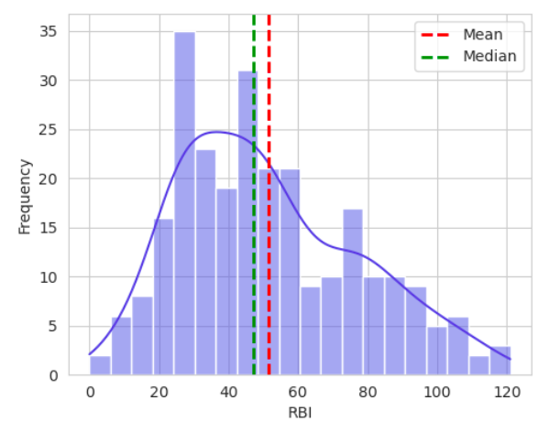
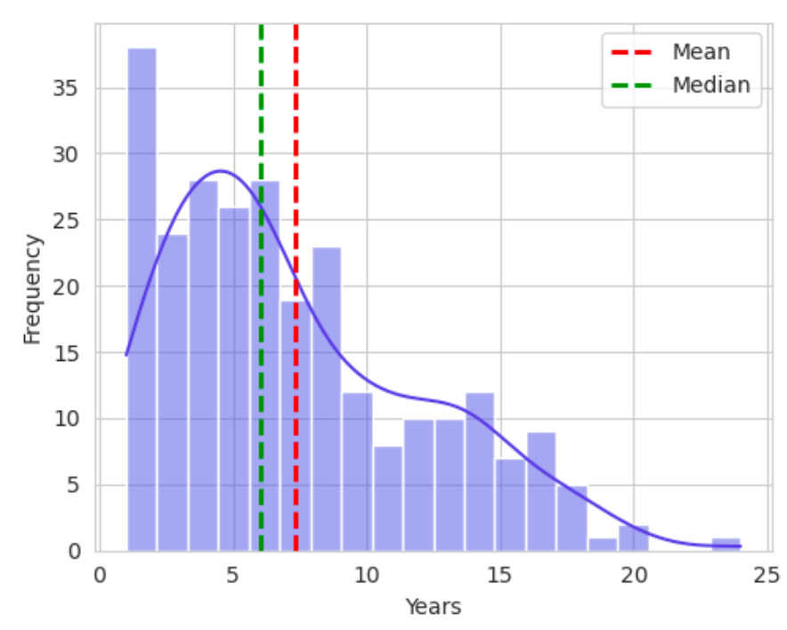
Salary Distribution
Highly positively skewed distribution. A lot of outliers on the high end. These outliers will be kept since it represents either an elite player or long-term contract. A transformation such as log scale could help normalize the distribution.
OUTLIER ANALYSIS & DATA DISTRIBUTION
RBI Distribution
Positively skewed distribution. No outliers detected in RBIs.
Years in League Distribution
Slightly positively skewed distribution, possibly bimodal. A few outliers on the high end. These outliers will be kept since it represents either a long-term contract or long tenure.
Page 05

Slide 6
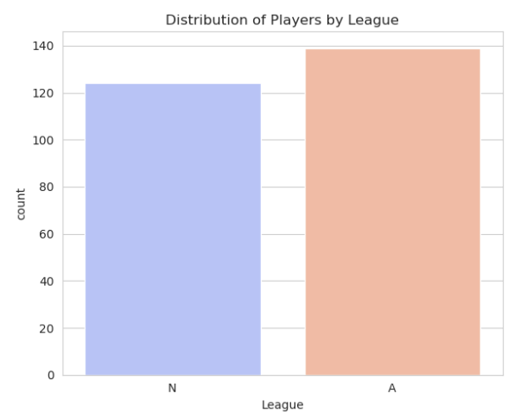
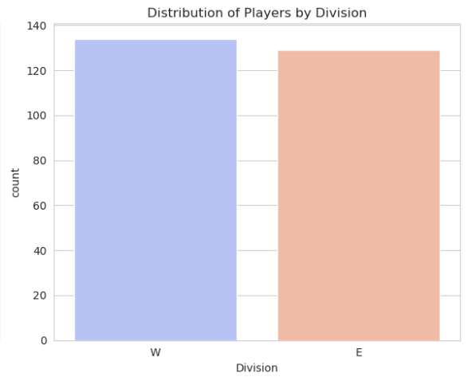

DATA DISTRIBUTION
National vs American League
West vs East Division
The distribution between the two leagues is relatively balanced but there are slightly more players in the American league.
04
The distribution between the two divisions is relatively balanced but there are slightly more players in the West division.
Page 06

Slide 7


DESCRIPTIVE STATISTICS
Numerical Variables
Variable | Mean | Mode | Standard Deviation | IQR | Skewness | Kurtosis
Hits | 107.83 | 70.0 | 45.13 | 70.0 | 0.24 | -0.54
Home Runs | 11.62 | 5.0 | 8.76 | 13.0 | 0.79 | -0.18
RBI | 51.49 | 29.0 | 25.88 | 41.0 | 0.56 | -0.41
Salary | 535.93 | 750.0 | 451.12 | 560.0 | 1.59 | 3.06
Years | 7.31 | 4.0 | 4.79 | 6.0 | 0.81 | -0.06
Numerical Variable Summary
As you can see from the figure, salary has a mean of $535k but an even higher mode of $750K. This shows that there might be a skew. Based on IQR and the standard deviation, salary shows the largest spread meaning that there’s a wide range in player earnings. By viewing the skewness and kurtosis results, you can see that hits, home runs, RBI, and number of years in the league have a right skew. This suggests that the performance metrics lean more towards the left side, so the lower end.
Page 07

Slide 8
DESCRIPTIVE STATISTICS
Categorical Variables
Variable | Mode | Frequency Count
League | American | American: 139 National: 124
Division | West | West: 134 East: 129
Categorical Variable Summary
There is slightly more players in the American league versus National league. Same goes for the West division. There is slightly more players in the West division versus East division.
Page 08

Slide 9
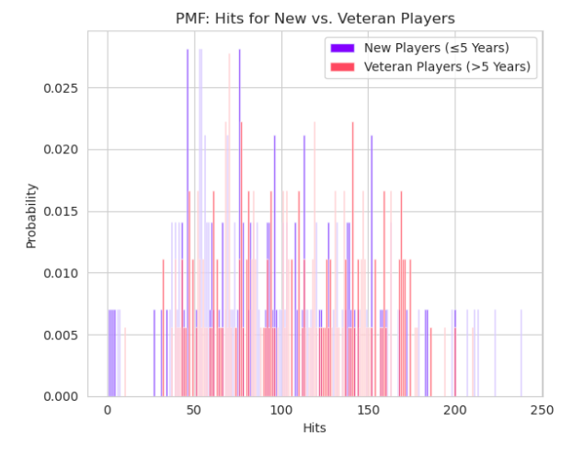

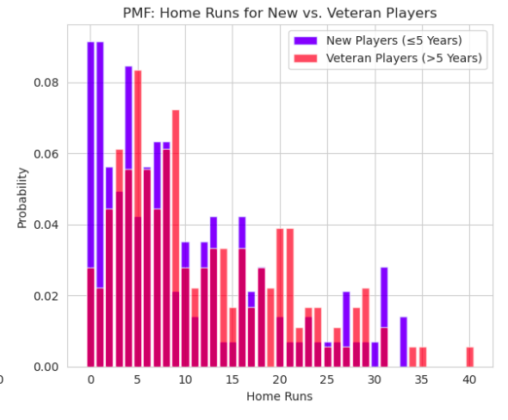
PROBABILITY MASS FUNCTION ANALYSIS
Hits (New vs Veteran Players
New players who have played less than 5 years are more likely to have fewer hits, with most falling below 100. Veteran players who have played more than 5 years are more likely to have a higher hit count especially near the upper end of the distribution. This suggests that veteran players tend to have a higher hit count, supporting the hypothesis that more experience leads to higher performance.
Home Runs (New vs Veteran Players
New players who have played less than 5 years have higher probability of hitting between 0 to 5 home runs. Not a lot of new players hit more than 10 home runs. Veteran players, on the other hand, are more likely to hit 10 home runs or more. This supports the hypothesis, in that, players with more years of experience tend to have a higher performance level.
Page 09

Slide 10

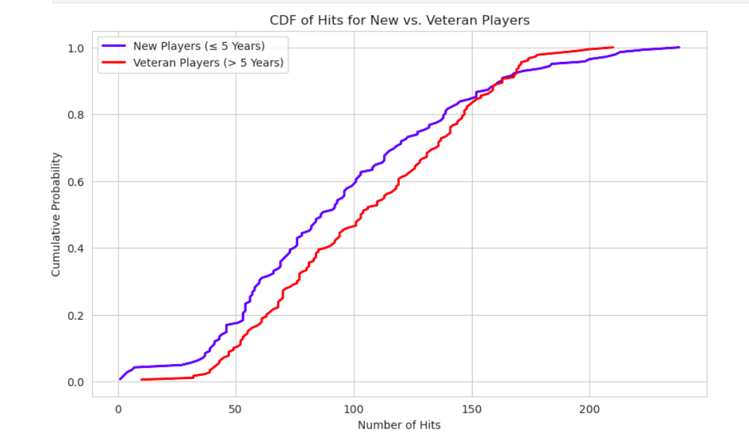
CUMULATIVE DISTRIBUTION FUNCTION ANALYSIS
The CDF result shows that new players tend to have fewer hits, as represented by the blue line, which rises more steeply at the beginning. This indicates that new players tend to have more lower hit counts. For veteran players though, the red line is shifted more to the right, showing that these players typically have more hits. As we look at players with higher hit counts, the gap between new and veteran players gets bigger, with veteran players having more hits overall. The CDF supports the idea that more experience correlates with higher hit counts.
Page 10

Slide 11

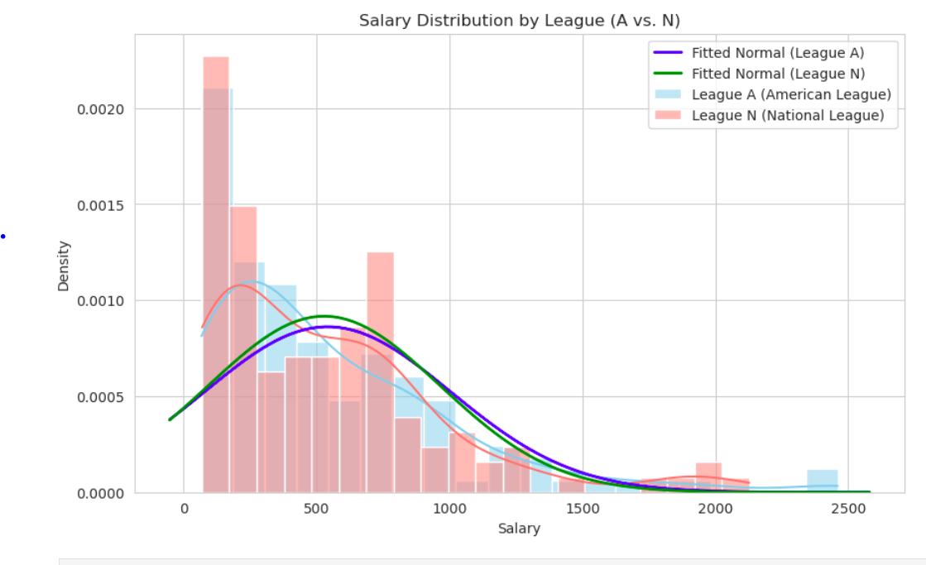
SALARY DISTRIBUTION ANALYSIS
League Impact on Salary
The results show that the American league tends to have slightly higher salaries than the National League. The leagues have very similar salary ranges; however, the distribution for the American league is shifted very slightly to the right, showing that people in that league on average earn more than the National league. The results indicate that league might have an impact on salary. Since the distribution between the leagues is very similar, it might be beneficial to confirm if this difference is statistically significant.
Page 11

Slide 12
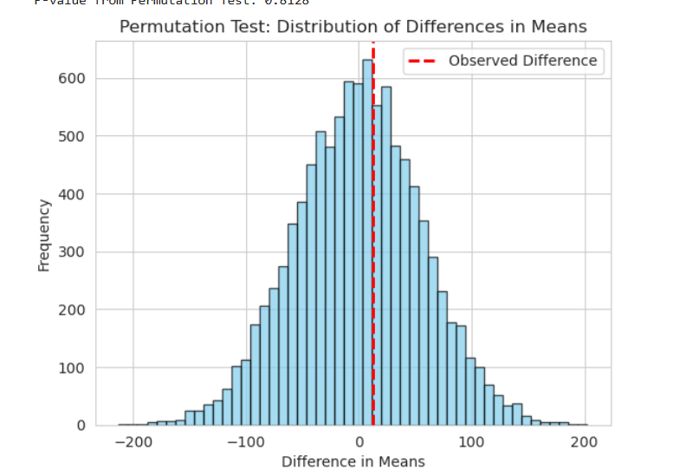



PERMUTATION TEST ANALYSIS
The permutation test shows that there's no real difference in salaries between the American League and the National League. The average salary difference is about $12,882, with American league players making a bit more. However, the p-value of 0.813 is much higher than the usual significance level of 0.05. This means there's an 81.3% chance that the observed difference could be due to random chance, not because of the league. So, we can't say for sure that being in one league makes a big difference in salary. The results indicate that we fail to reject the null hypothesis, which suggests that the league has no real impact on salary. The results conclude that the difference in salaries between the two leagues is not statistically significant.
Page 12

Slide 13
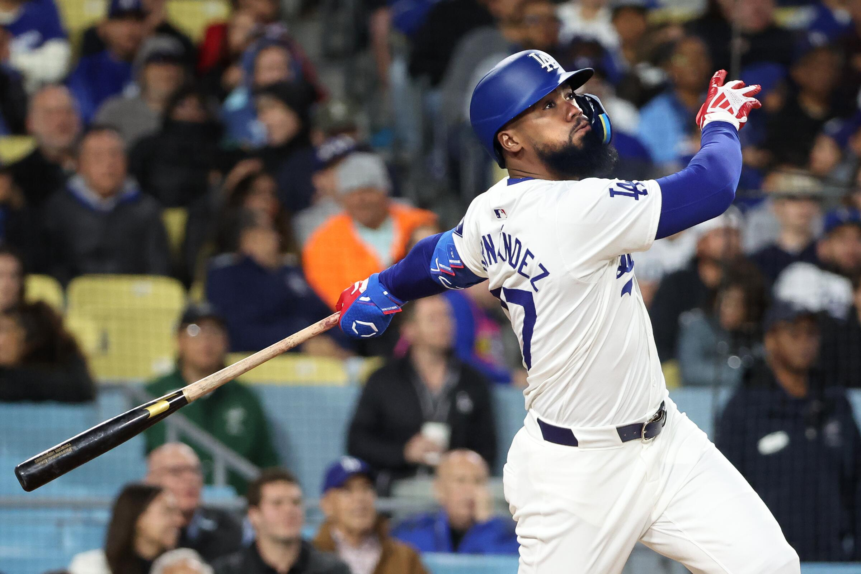
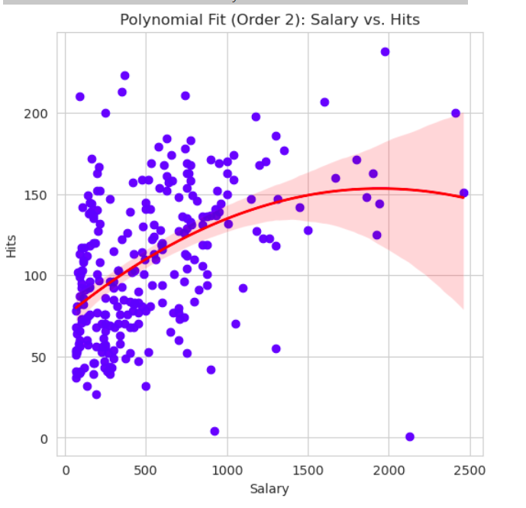
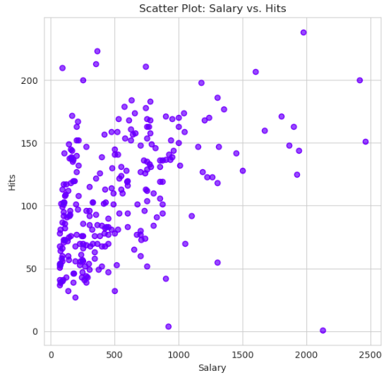
SCATTER PLOT ANALYSIS
Covariance: 8930.05
This positive covariance shows that salary and hits tend to increase together.
Pearson's Correlation: 0.439
This moderate positive correlation indicates that players with more hits tend to earn higher salaries. However, the relationship isn’t very strong, as seen from the scatter in the plot.
Non-Linear Relationships:
The scatter plot hints at a possible non-linear relationship. The polynomial fit curve suggests that at higher levels of hits, salary increases at a slower rate.
Salary vs Hits
Page 13

Slide 14
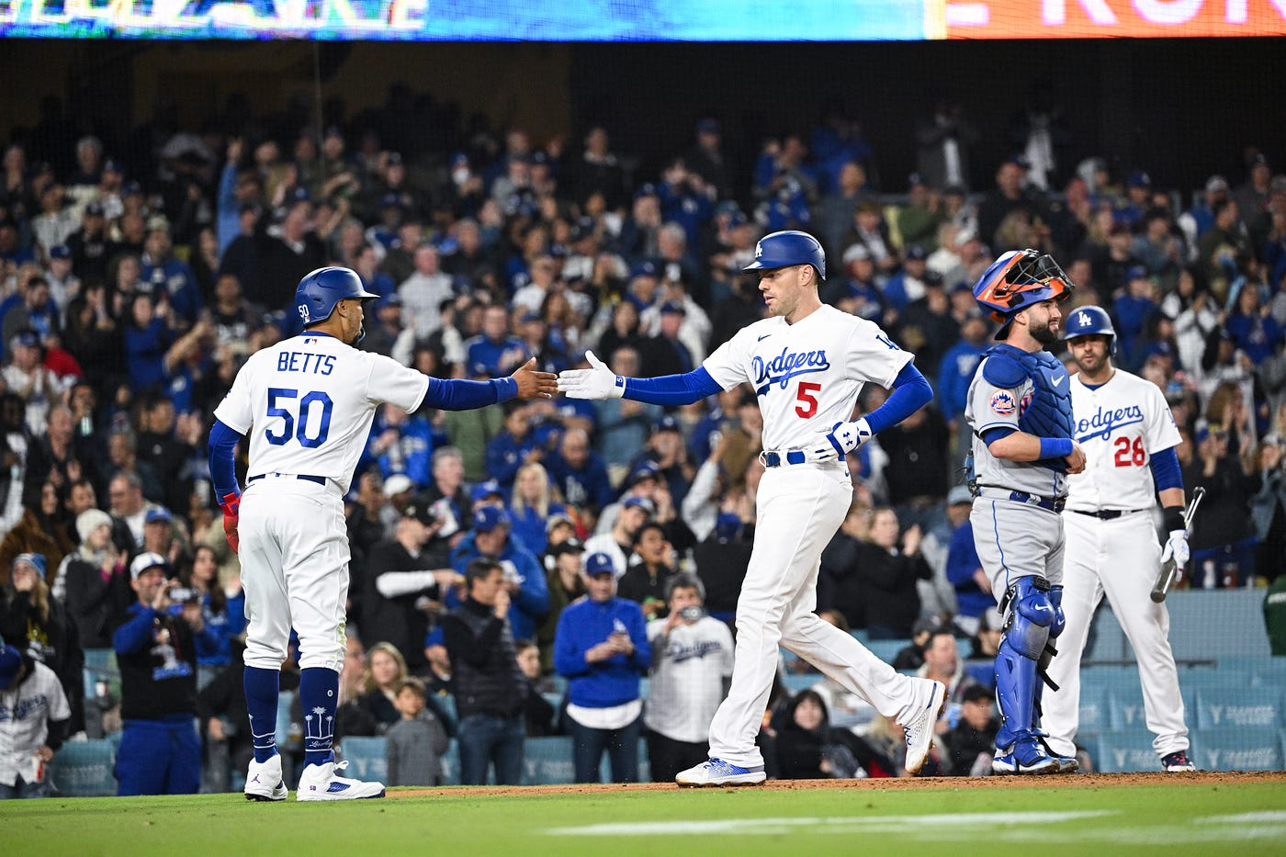
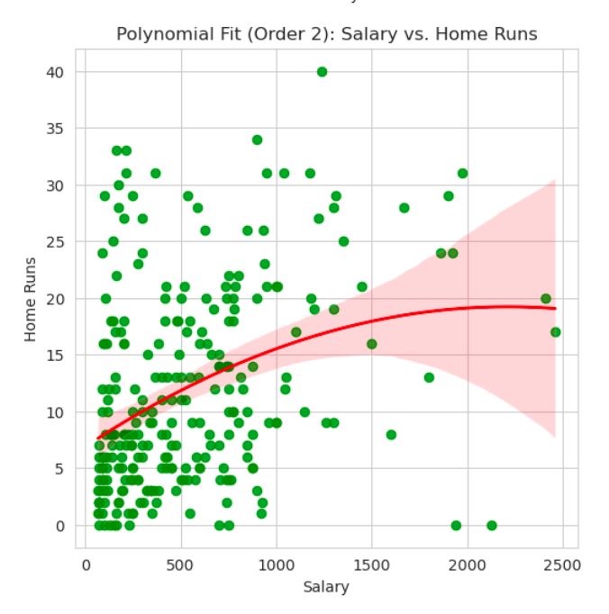
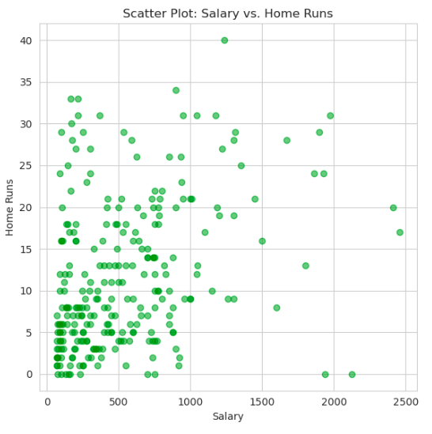
SCATTER PLOT ANALYSIS
Covariance: 1355.13
This positive covariance shows that salary and home runs also tend to increase together.
Pearson's Correlation: 0.343
The weaker correlation compared to hits shows that the linear relationship between salary and home runs isn’t as strong. This is reflected in the more scattered data points.
Non-Linear Relationships:
The scatter plot hints at a possible non-linear relationship. The polynomial fit curve suggests that at higher levels of home runs, salary increases at a slower rate.
Salary vs
Home Runs
Page 14

Slide 15

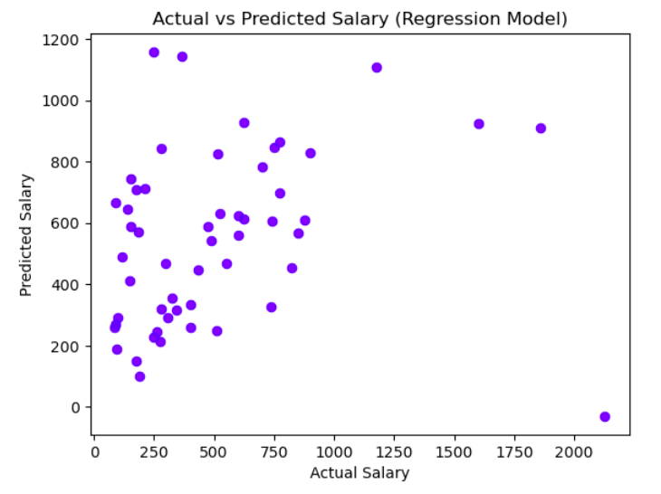
REGRESSION ANALYSIS
The scatter plot shows how well the model’s predictions aligns with the actual salaries. As you can see from the plot, the points do not fall within a straight line. Instead, the points are spread out. Although there’s a slight trend, the model still isn’t very precise. It shows that the model either over predict salaries or under predict salaries.
Page 15

Slide 16
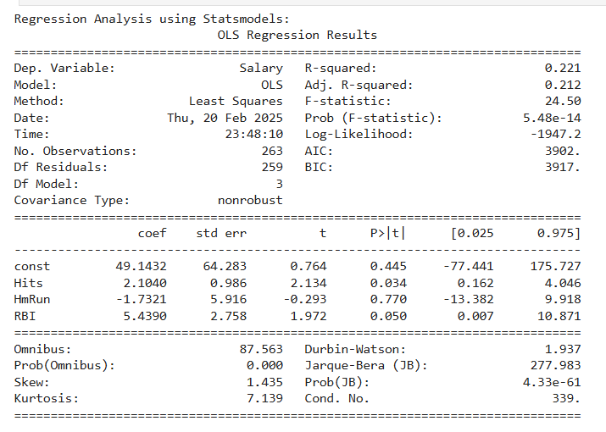
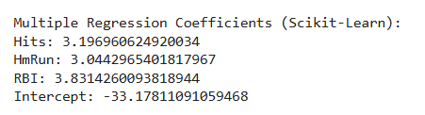
REGRESSION ANALYSIS
The statsmodels results show that the R-squared value of 0.221 means the model only explains 22% of the variation in salaries. This indicates that other variables also plays an important part in predicting salaries. The F-statistic value of 24.50 and p-value of 5.48e-14 show that at least one of the stats (Hits, Home Runs, RBI) does impact salary. By reviewing the coefficients, it shows that hits has a positive impact, so each additional hit adds about $2,104 to salary (p = 0.034), and each extra RBI adds $5,439 (p = 0.050). These variables are both statistically significant. Home runs though shows a negative impact (-$1,732), but this isn’t statistically significant (p = 0.770). This might be due to multicollinearity issues, in that, these stats are too closely related to each other.
Unlike the results of the statsmodels, the scikit-learn results show that all three variables, hits (3.20), home runs (3.04), and RBIs (3.83) has a positive impact on salary. The difference in results likely comes from how the two models handle the data.
Page 16

Slide 17

THANK YOU FOR EXPLORING BASEBALL METRICS WITH ME!
Page 17

